Slide 1
Dengue Prediction
Natasha MC
DSI7- Capstone project

Slide 2


Given a train set with 24 features and a test set with 23 features- missing column of ‘total_cases’. Only 1456 rows in the train set :)
Goal is to predict the total_cases in the test with the regressor model of mean absolute error (MAE). More robust to outliers compared to MSE.
Features: 'city', 'year', 'weekofyear', 'week_start_date', 'ndvi_ne', 'ndvi_nw', 'ndvi_se', 'ndvi_sw', 'precipitation_amt_mm', 'reanalysis_air_temp_k', 'reanalysis_avg_temp_k', 'reanalysis_dew_point_temp_k', 'reanalysis_max_air_temp_k', 'reanalysis_min_air_temp_k', 'reanalysis_precip_amt_kg_per_m2', 'reanalysis_relative_humidity_percent', 'reanalysis_sat_precip_amt_mm', 'reanalysis_specific_humidity_g_per_kg', 'reanalysis_tdtr_k', 'station_avg_temp_c', 'station_diur_temp_rng_c', 'station_max_temp_c', 'station_min_temp_c', 'station_precip_mm'

Slide 3
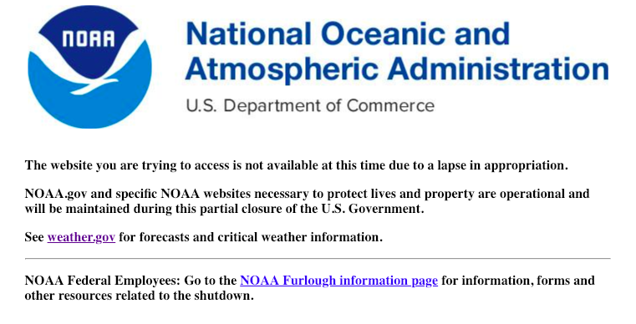
Exploratory Data Analysis of Features
Null values: .fillna(method = 'ffill') Important for continuity in Time Series
Iquitos dataset: total case values in 2000&2001 were hardly populated. Dropped those 2 years.
53 weeks: https://en.wikipedia.org/wiki/ISO_week_date: An ISO week-numbering year (also called ISO year informally) has 52 or 53 full weeks. That is 364 or 371 days instead of the usual 365 or 366 days.

Slide 4
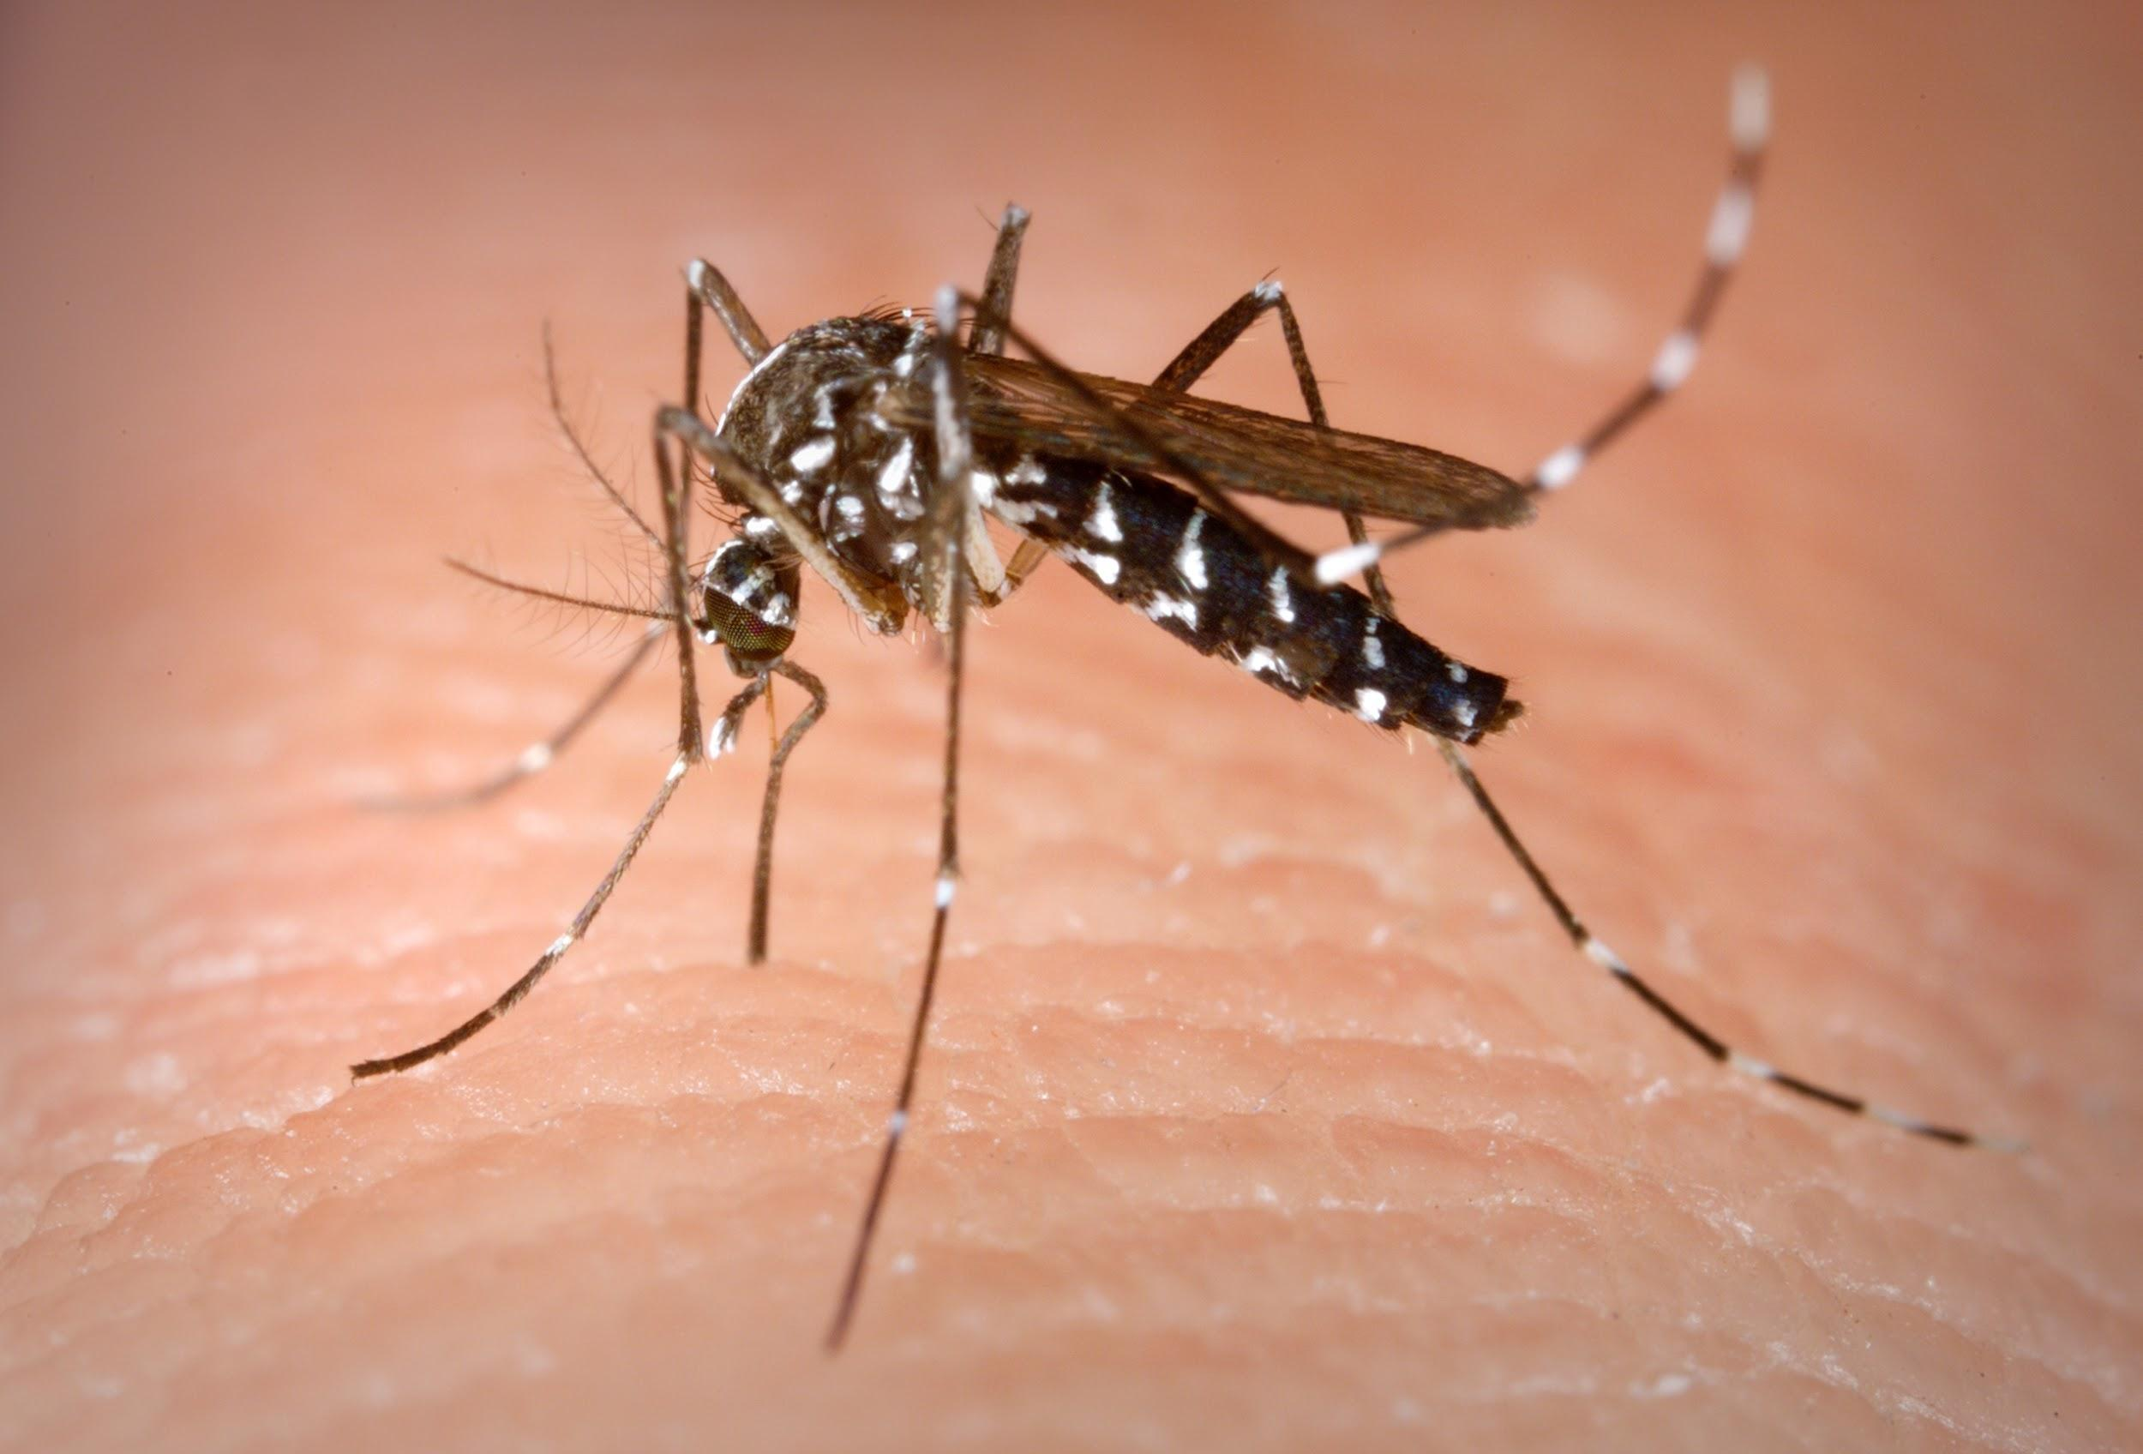
Dengue stats
Spread by the Aedes mosquito
Before 1970, only 9 countries had experienced outbreaks. Now over 100 countries have.
WHO indicates 390 million dengue infections per year (95% credible interval 284–528 million), of which 96 million (67–136 million) manifest clinically (with any severity of disease)
Dengue fever is a severe, flu-like illness that affects infants, young children and adults, but seldom causes death.
The virus is transmitted to humans through the bites of infected female mosquitoes. After virus incubation for 4–10 days, an infected mosquito is capable of transmitting the virus for the rest of its life.
Infected symptomatic or asymptomatic humans are the main carriers and multipliers of the virus, serving as a source of the virus for uninfected mosquitoes. Patients who are already infected with the dengue virus can transmit the infection (for 4–5 days; maximum 12) via Aedes mosquitoes after their first symptoms appear.

Slide 5

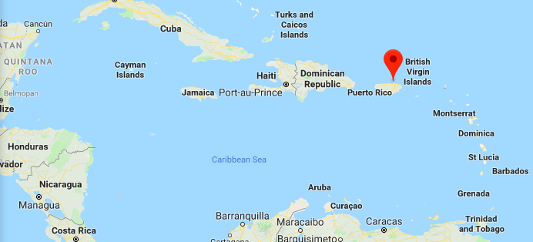
San Juan, Puerto Rico
Capital of Puerto Rico, part of the US.
Population: 355,000
Density: 8,253/sq mi
Median Household income: $20k
Individuals below poverty line: 42%

Slide 6
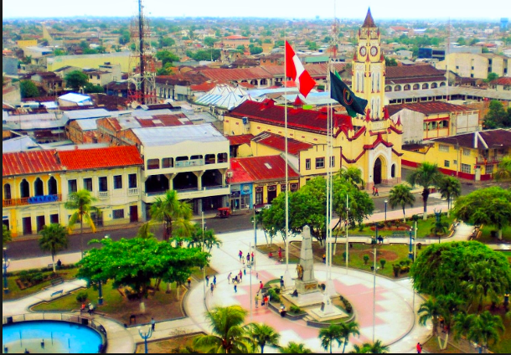
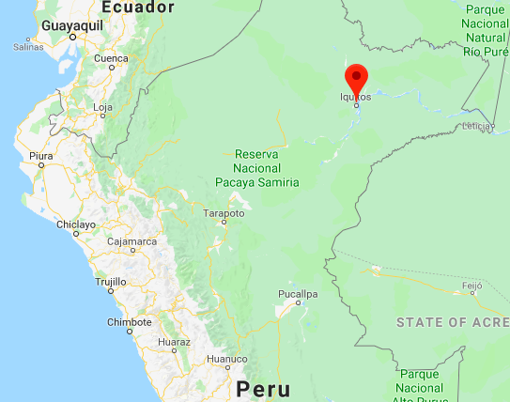
Iquitos, Peru
Population of 430k, 6th largest town
Median Household income: $6k

Slide 7
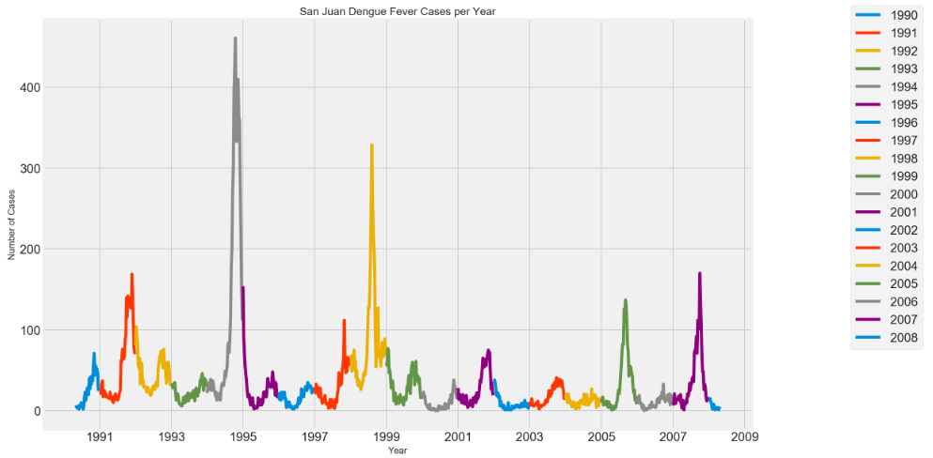

Slide 8
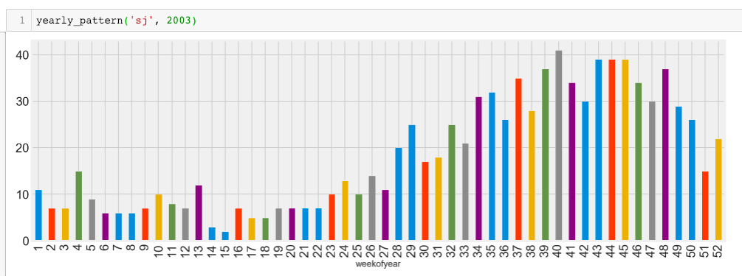

Slide 9
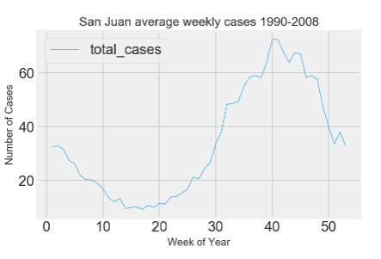
Seasonal dengue cases in San Juan
Baseline is 34.18 cases/week.
January to July: Low season. August to December: High season

Slide 10
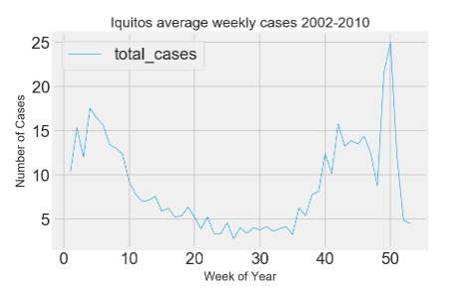
Seasonal dengue cases in Iquitos
Baseline: 8.86 cases/week. Less clear pattern.
March to September: Low season. October to February: High season.

Slide 11
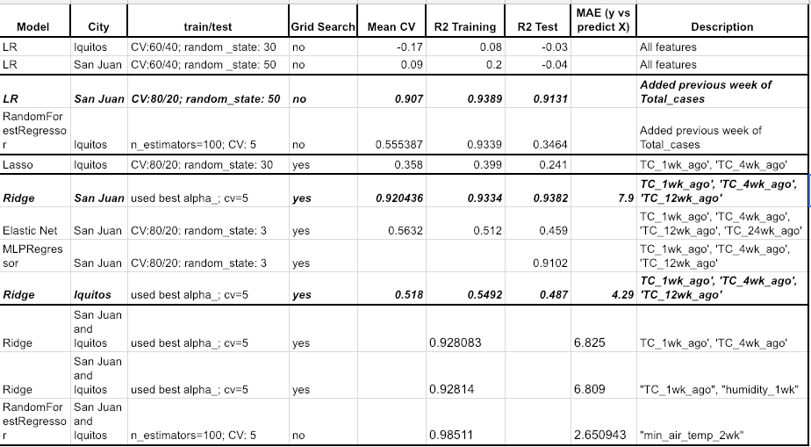
Some modelling!
Bear in mind the lower the MAE, the better > current leader is on 11.944

Slide 12
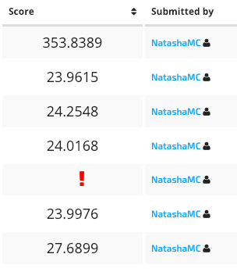
Competition submissions....
Linear regression with 1 added engineered feature (TC_wk1) both San Juan and Iquitos: MAE 353.8389 (!!)
However, LR model for San Juan but the mean for Iquitos. MAE: 23.9615
Submitted various other models but were in the 24-28 range.

Slide 13
Risks & Limitations
Collecting correct data: dengue is easily misdiagnosed
Many factors play a part: urbanisation, population density, sanitation, near water environments & new research suggest climate change.
Impossible to predict devastating outbreaks
Next steps:
Use the .diff(), engineer more features, add more data once US sites are up.

Slide 14

Questions?

